Slide 1
D.I.C.E
Dynamic Image Compression Engine
Theory of Operation John Hofmeyr - 04/05/2024

Slide 2
D.I.C.E| Project Goal
Problem
Significant bandwidth, memory and processing power is needed to handle modern image sensor data rates
Objective
Design a system that dynamically compresses image sensor data, reducing required bandwidth, memory capacity and processing power needed to process images
Utilize contrast and location-based weights to determine image compression amounts
Maximizes data reduction while maintaining image quality in high detail locations
Re-stitch images to create coherent output image
Provide user interface for controlling image processor

Slide 3
FPGA Processor ToE

Slide 4

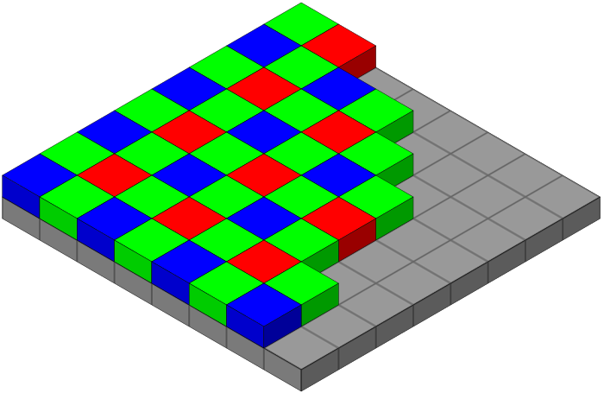
D.I.C.E| Stage 1 - Image capture
Image Sensor Output
IMX477 sensor captures 4056x3040 10-bit RAW images
Maximum frame rate of 60FPS
Each frame requires ~124Mb to store
~7.4Gb/s of bandwidth needed for 60FPS stream
Images are received in Bayer mosaic form
Sample Image from Sensor
Bayer Mosaic Sensor Format

Slide 5
D.I.C.E | Stage 2 - Image Ingest & Tiling
Image Ingest
FPGA receives image data via 4 Lane MIPI bus @ 2.1Gb/s per lane
Image is scanned from top left to bottom right, image frame is buffered in DRAM
Image Tiling
Image is divided into NxN image tile grid
Grid is user selectable, must be 2x2, 3x3 or 4x4
Limited by resource availability on FPGA
Higher tile count increases resource usage
4x4 Image tile | 1014x760px blocks

Slide 6
D.I.C.E | Stage 3 - Image Pre-processing
4x4 Image tile | 1014x760px blocks
Pixel Group Average Intensity (0-1024)
Image Tile Intensity Comparison
Tile (2,3)
500 | 900 | 200 | 400
700 | 300 | 130 | 400
350 | 120 | 400 | 400
450 | 400 | 400 | 400
Image Tile Pixel Groups
Each Sub-Tile is averaged
Image Tile Pixel Groups
Image Tiles and subdivided into 4x4 grids (Pixel Groups)
Image contains a total of 256 Pixel groups
Pixel groups contain 48,165 pixels each
Intensity Differences
600 |  | 270
330 |  | 0
280
Pixel Group Processing
Pixel intensities are averaged for each pixel group
Resulting 16 average intensities are compared in blocks of 4 sub-tiles, 5 comparisons total
Difference in intensity is calculated for each comparison
Two tiles with largest intensity difference are subtracted
Intensity differences are averaged to obtain the Contrast Wight
Tile Contrast Weight = 296
*Intensity Values are for example only

Slide 7
D.I.C.E | Stage 4 - Image Tile Compression Weights
Image Tile Location Weights
Tile location weights infer that primary image detail is located in center of image
Location weight increases from center of image out
Location Weight determines contrast weight increase
Image Tile Compression Weights
Location Weight = 0
No contrast weight increase
Location Weight = 1
Increases contrast weight by 50%
Location Weight = 2
Increases contrast weight by 100%
Compression Ratio Calculation
Final weight values for Image tile used as input to lookup table
Compression ratios range from 0-3
Compression ratio used to re-size image tiles after compression for tile restitching
4x4 Image tile | 1014x760px blocks
LW:2 | LW:1 | LW:1 | LW:2
LW:1 | LW: 0 | LW:0 | LW:1
LW:1 | LW:0 | LW:0 | LW:1
LW:2 | LW:1 | LW:1 | LW:2

Slide 8
D.I.C.E | Stage 5 - Image Tile Compression
Image Compression Engine
Tiles are loaded into FPGA BRAM in chunks of 16 Pixel Rows
Requires ~650Kb
Lossy or Lossless compression is applied
Compression engine output is buffered into 2nd 650Kb BRAM block
Data transactions from RAM to BRAM are done in 650Kb blocks
4056x16 px
Image Tiles
Compression Engine Output
4x Compression Cores

Slide 9
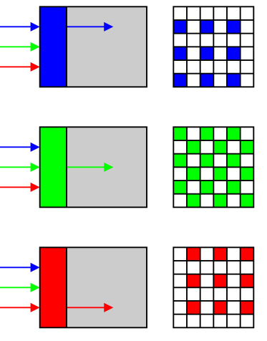
D.I.C.E | Stage 6 - Image Tile De-bayer & Re-size
Image Tile De-bayer
After compression, image tiles pass through 4x debayer cores
Bilinear, nearest neighbor or edge detect
Image Tile Pre-processor
Debayered RGB image is passed through RGB-HSV-RGB Post-processor
Can apply color correction to image
Final image re-sized to match original image capture size or match user defied resolution
Final image stored in RAM, Displayed over HDMI or formatted as JPEG and sent to host machine via USB
4x post-processor Cores + Resize Cores
HDMI DRAM
USB
4x post-processor Cores + Resize Cores
4x Debayer Cores
4x post-processor Cores + Resize Cores
4x post-processor Cores + Resize Cores

Slide 10
D.I.C.E | System Resources
XC7K160T FPGA
162,240 Logic Cells
25,350 Logic Slices
2.18Mb Distributed RAM
11.7Mb Block Ram
36Kb Dual Port BRAMs With FIFO & ECC
600 DSP48E1 Cores
25x18b two’s-complement Multiplier
48-b Accumulator
Add/Sub/Accumulate SIMD
Dual 24b or Quad 12b Add,Sub,Accumulate
ALU
AND, OR, NOT, NAD, NOR, XOR, XNOR
Patern Detector
25W Maximum Power Dissipation
20A on VCCINT (1V)
2A on VCCIO/VCCAUX (1V8)
DDR3 DRAM
MT41J128M16JT-125:K TR
2Gb (128M x 16)
16b Data bus @ 800Mhz (1600MT/s)
3.2GB/s or 25.6Gb/s data rate per chip
Two Chips total
4Gb total
6.4GB/s (51.2Gb/s) Uni-directional or 3.2GB/s (25.6Gb/s) bi-directional
Separate DDR Controllers (One per chip)

Slide 11
FPGA – MCU Interface

Slide 12
Hardware – Host PC Interface

